Slide 1
Database Management Systems Homework: Bank Project
Nuriye Merve Tatlıdil

Slide 2
What program did I use when creating my database?
I created my database with Python SQLite
SQLite is a database library that is very simple to use and install
Since SQLite does not need any servers to run, there are no setup or configuration steps.
There is only one file for each database. This makes it easy to back up and copy the database.

Slide 3
What did I think?
I wanted to make bank database because my future dream is to work as a database manager in a bank.
I wanted to make a simple database of a bank. I have 6 entities in the database. I used SQLite Table constraints when creating the database. The database also consists of sample data.

Slide 4

There is a bank.

Slide 5
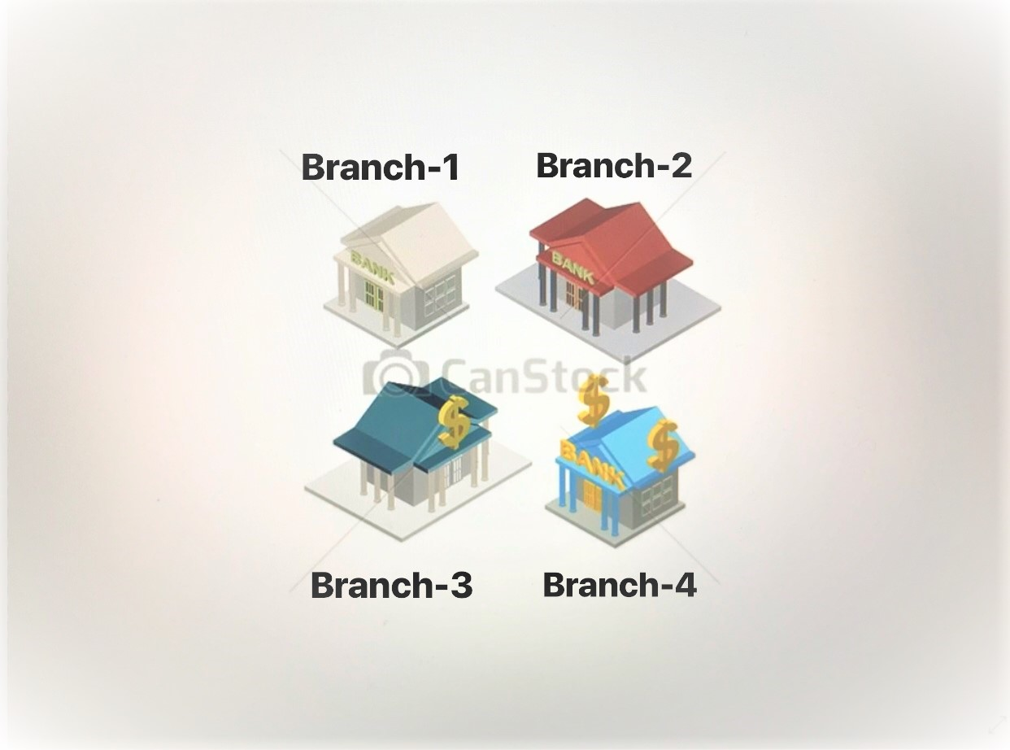
BANK
The bank has branches.These branches have customers and bankers. Customers have credit cards, accounts and loans.

Slide 6


Slide 7
Entity-Relationship Model (E-R)

Slide 8
banker_customer_branch
branch_city
banker
branch
banker_id
branch_id
banker_mail
branch_name
assets
banker_name
loan_
branch
customer_id
customer_name
borrow
customer
loan
customer_city
customer_street
amount
loan_id
credit_card_id
limit
account_id
balance
expired_date
customer_ credit_ card_account
credit_card
account
category

Slide 9
RELATIONSHIP
loan-branch (N-1)
loan-credit_card(N-N)
customer-credit_card(N-N)
customer-account(N-N)
credit_card-account(N-N)
banker-branch(N-N)
banker-customer(N-N)
customer-branch(N-N)

Slide 10
Logical Model
banker- {banker_id , banker_name,banker_mail}
branch{branch_id, branch_city,branch_name,assets}
customer{customer_id, customer_name,customer_street,customer_city}
loan{loan_id, amount,branch_id}
credit_card{credit_card_id, expired_date,limit}
account{account_id, balance,category}

Slide 11
Logical Model
loan_customer{loan_id,customer_id}
banker_customer_branch(banker_id,customer_id_branch_id}
customer_credit_card_account{customer_id,credit_card_id,account_id}

Slide 12
Physical Model

Slide 13
Create table banker
( banker_id Integer,
banker_name Char(15),
banker_mail Char(15),
Primary key (banker_id));
Create table branch
( branch_id Integer,
branch_city Char(15),
branch_name Char(15),
assets Integer,
Primary key (branch_id));
Create table loan
( loan_id Integer,
amount Integer,
Primary key (loan_id),
Foreign key (branch_id) references branch (branch_id),
ON UPDATE CASCADE );

Slide 14
Create table customer
( customer_id Integer,
customer_name Char(15),
customer_street Char(15),
customer_city Char(15),
Primary key (customer_id));
Create table credit-card
( credit_card_id Integer,
expired_date Date,
limit Integer,
Primary key (loan_id));
Create table account
( account_id Integer,
balance Integer,
category Char(10),
Primary key (account_id));

Slide 15
Create table loan_customer
( loan_id Integer,
customer_id Integer,
Primary key (loan_id,customer_id),
Foreign key (loan_id) references loan(loan_id),
ON UPDATE CASCADE,
Foreign key (customer_id) references customer(customer_id)
ON UPDATE CASCADE);
Create table customer_credit_card_account
( customer_id Integer,
credit_card_id Integer,
account_id Integer,
Primary key (customer_id,credit_card_id,account_id),
Foreign key (customer_id) references customer(customer_id),
ON UPDATE CASCADE,
Foreign key (credit_card_id) references credit_card(credit_card_id)
ON UPDATE CASCADE,
Foreign key (account_id) references account(account_id)
ON UPDATE CASCADE);

Slide 16
Create table banker_customer_branch
( banker_id Integer,
customer_id Integer,
branch_id Integer,
Primary key (banker_id,customer_id,branch_id),
Foreign key (banker_id) references banker(banker_id),
ON UPDATE CASCADE,
Foreign key (customer_id) references customer(customer_id),
ON UPDATE CASCADE,
Foreign key (branch_id) references branch(branch_id)
ON UPDATE CASCADE);

Slide 17
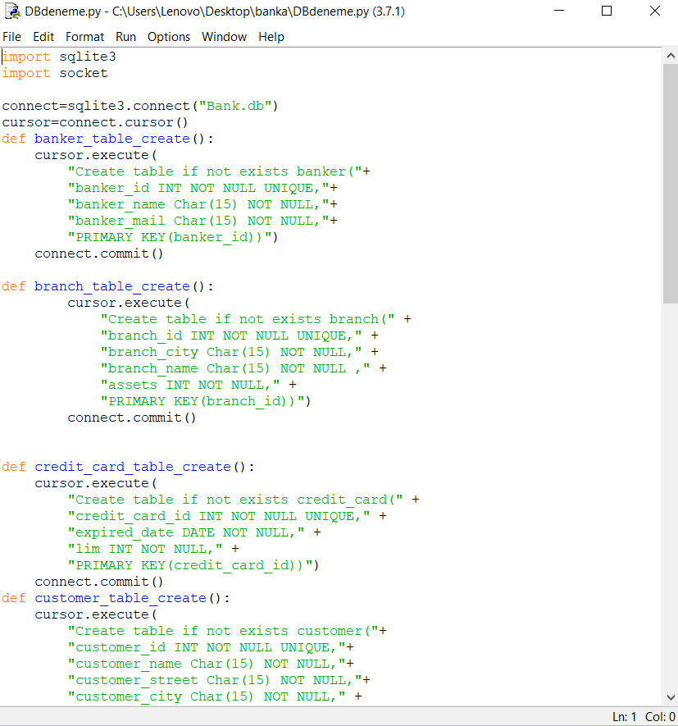
SQL code I wrote using SQLite

Slide 18
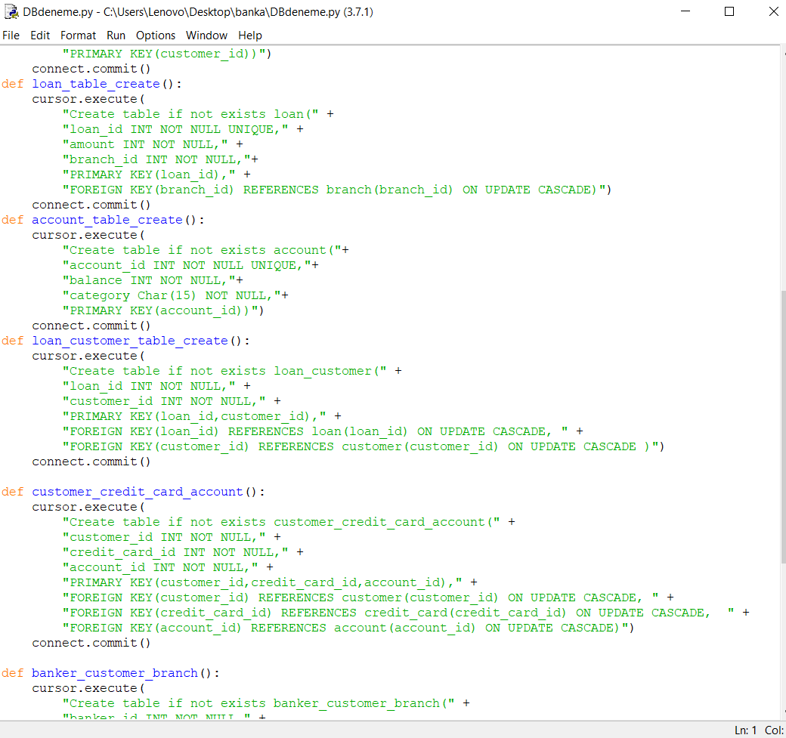
SQL code I wrote using SQLite

Slide 19
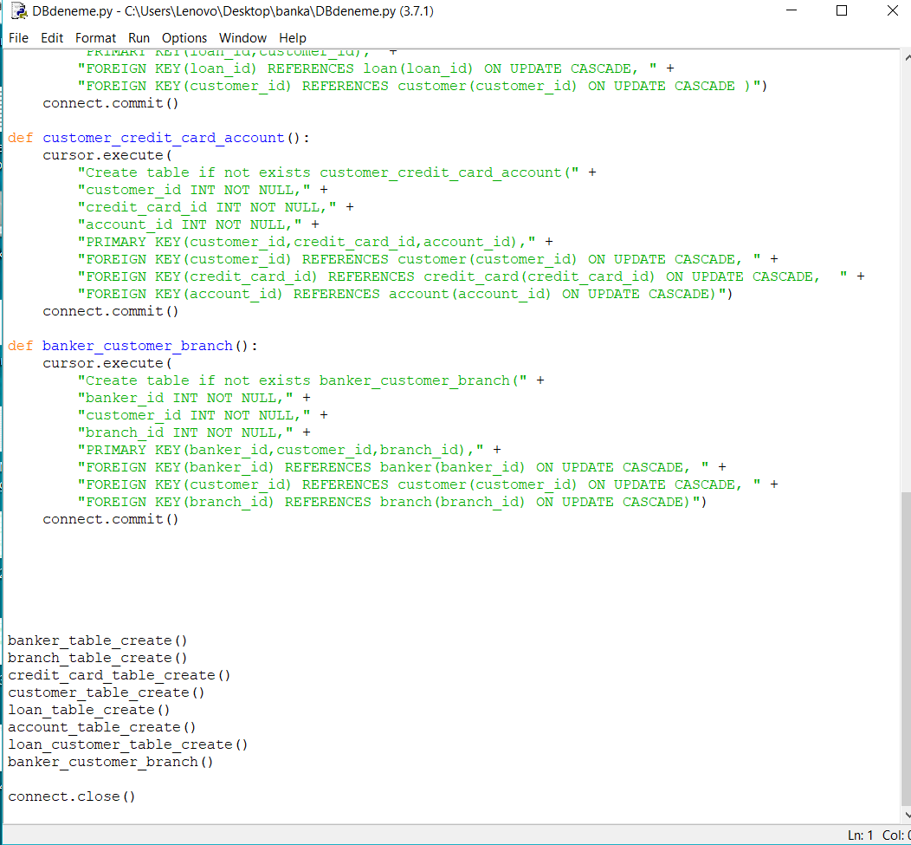
SQL code I wrote using SQLite

Slide 20
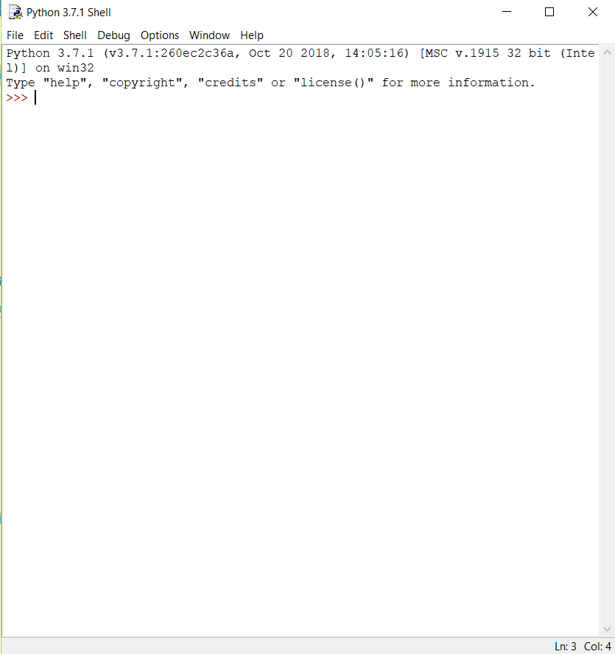
shell window before executing my database scripts

Slide 21
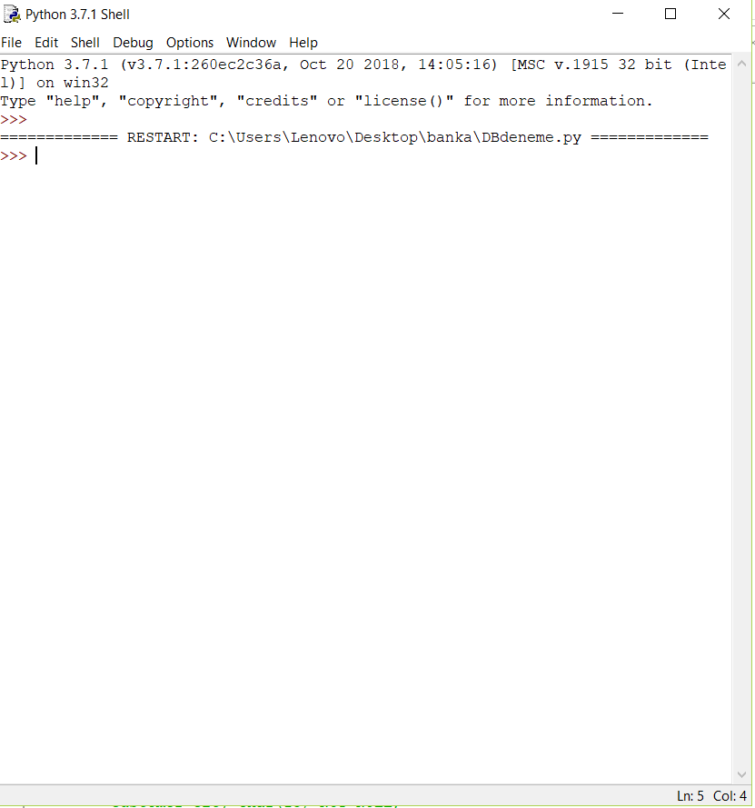
shell window after executing my database scripts

Slide 22
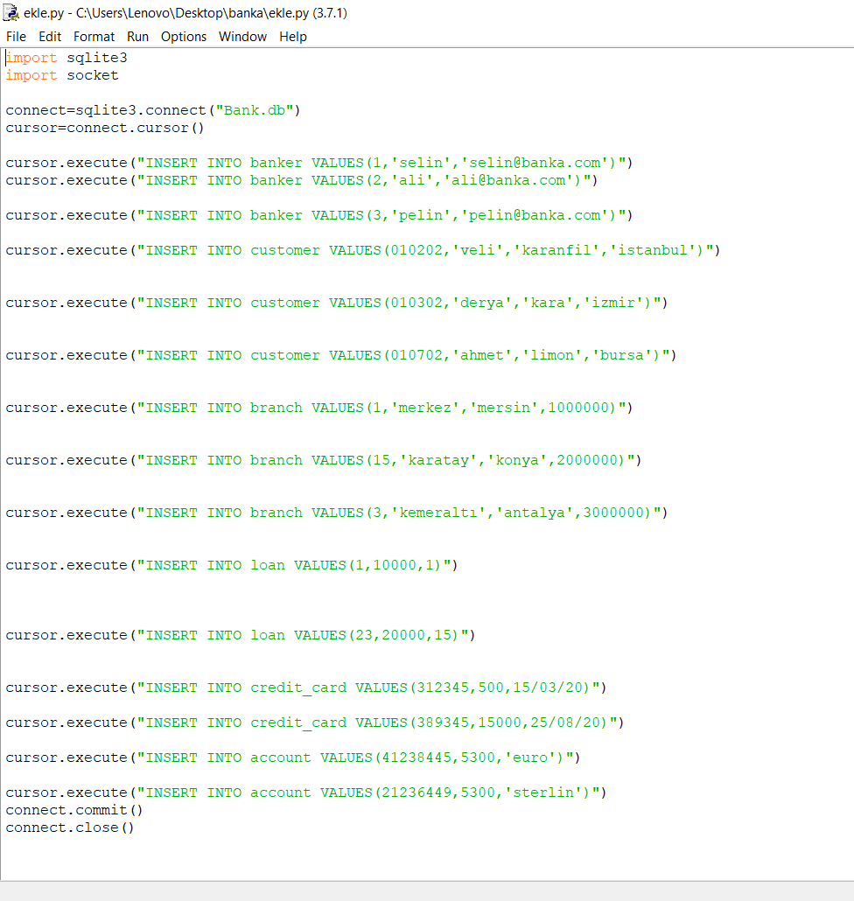
Adding sample data

Slide 23
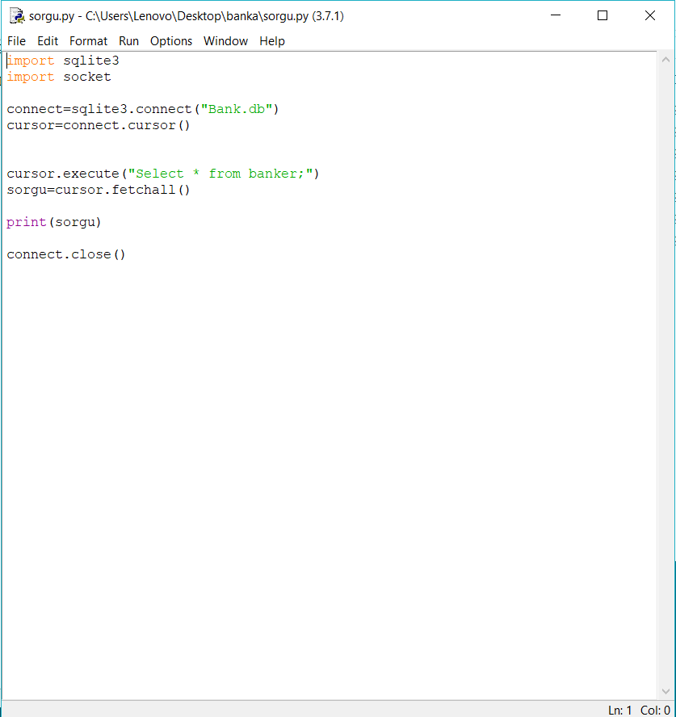
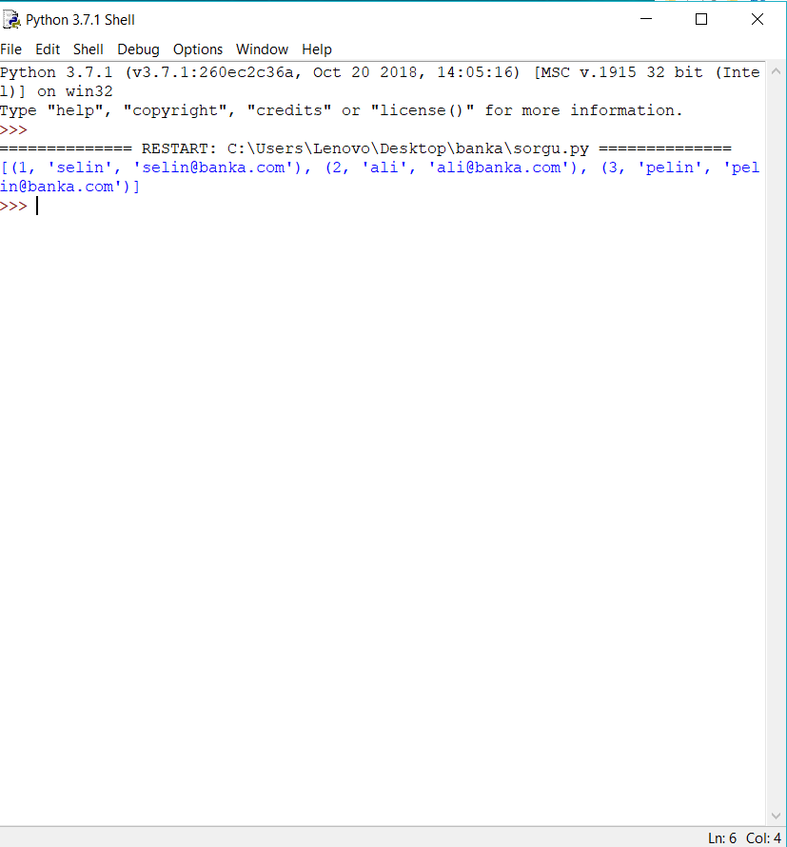
If ı write ‘’Select * from banker’’ command , What is the output equal to?

Slide 24
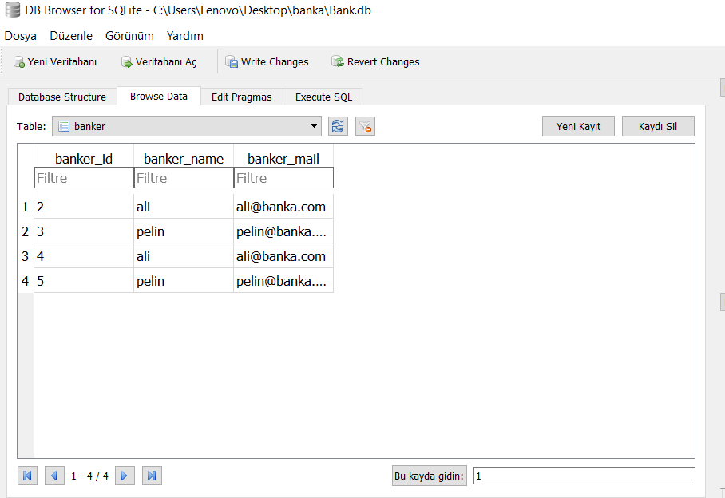
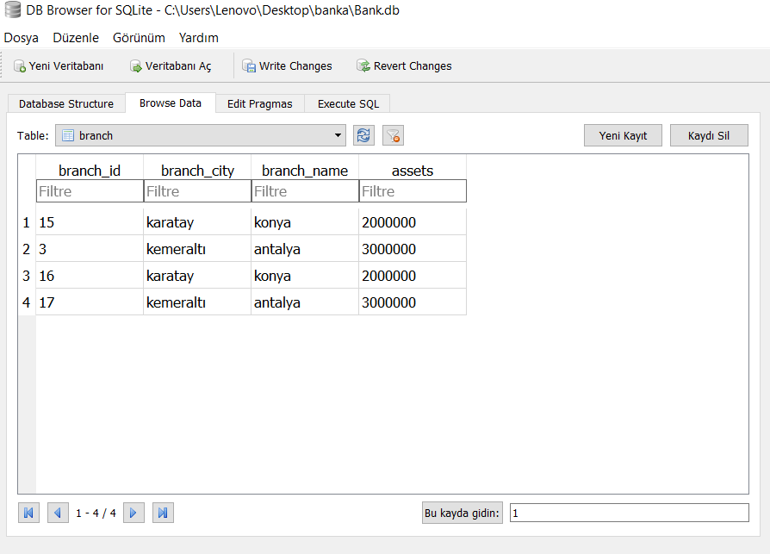
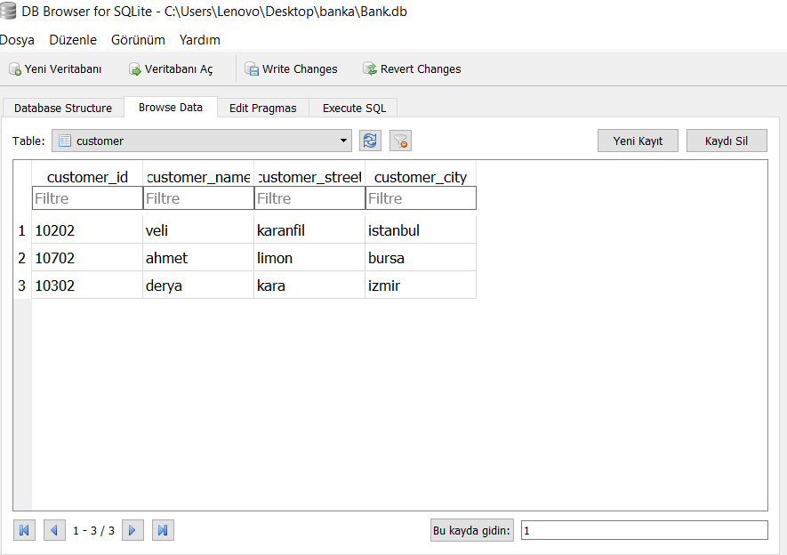

Slide 25
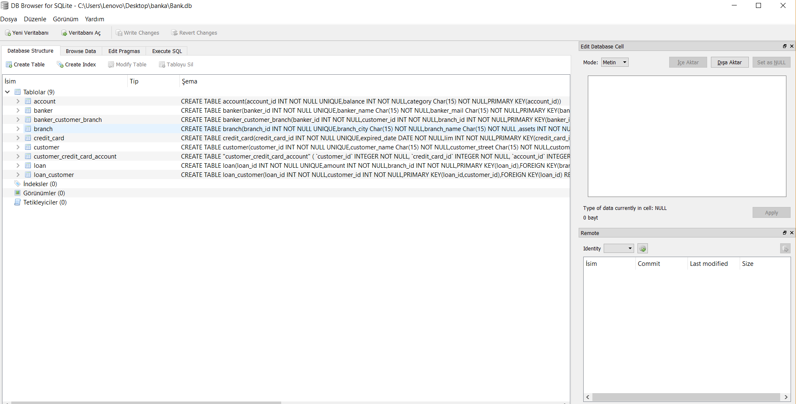

Slide 26

Thank you.

